Slide 1
Young carers awareness assembly
Carla, kara, and kerrianne
Enfield carers centre

Slide 3
Who are young carers?

Slide 4
Who are young carers?
A Young Carer is someone aged 18 or under who cares for, or looks after, a friend or family member who, due to illness, disability, a mental health problem or an addiction, cannot cope without their support.
They may also look after brothers, sisters or elderly relatives too.

Slide 5
Mental health conditions
Physical disabilities
A drug or alcohol problem
Long term illness
Learning disabilities
Notes:
Explain physical disabilities e.g. maybe they need a wheelchair or walking stick to get around

Slide 6
Things a young carer might do to help
Cheering up Helping at home Appointments Bills and Money Staying In
Calming down Looking after siblings Getting Ready Helping to communicate
Notes:
Could give an example of a young carer who tries to figure out what his older brother wants by the sounds he makes, or another young carer who helps to calm sister down as she gets upset easily.

Slide 7
How many Young Carers do you think there are in each class?
A) 6
B) 2
C) 1

Slide 8
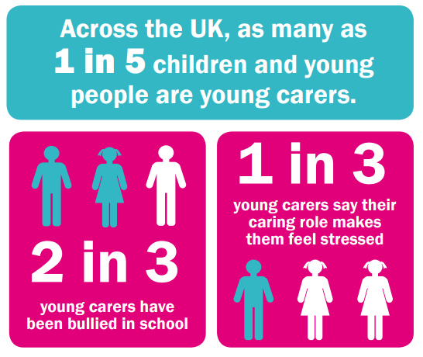
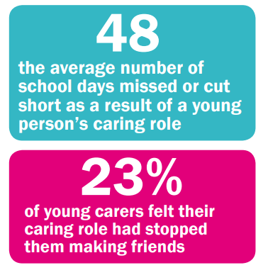
Why might young carers need support?
Notes:
Translate 1 in 5 children to roughly 6 children in each class.
They may miss school because they are looking after someone or no one can take them to school. They often get bullied especially because it is hard to make friends if you miss school a lot and can’t go to other people's homes to play or have people round easily. They miss out on their learning at school too.

Slide 9
Last WEEK, HOW MANY OF YOU…
Had a friend over to your home?
Went to a friend’s home?
Went to the park?
Attended an after-school club?
Attended a club out of school?

Slide 10
Young carers and siblings may…
Get into trouble Be late Struggle to complete
sometimes or miss school homework
Worry at school Feel sad or stressed Feel embarrassed

Slide 11
Who are we?
We support young carers aged 5-18 years old who care for someone
We have lots of ways we can help:
Chatting about how you are feeling
Helping with homework
Talking to your family and helping with anything you are worried about
Lots of trips and activities

Slide 12
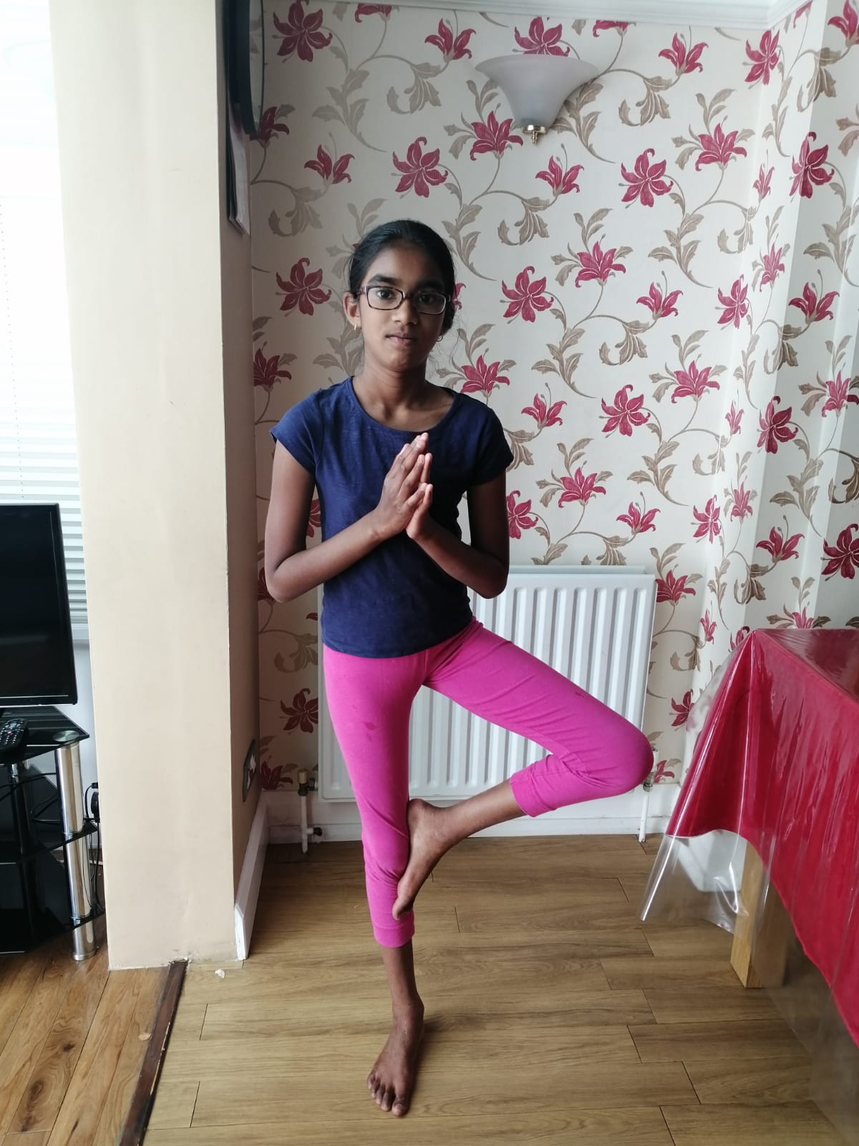
Young carers support
Support in school
Talk to someone
who listens
Mentoring
Homework Club
(in person and Zoom)
and SATs Club
Family
Support
Fun activities on Zoom
AND real life!

Slide 13
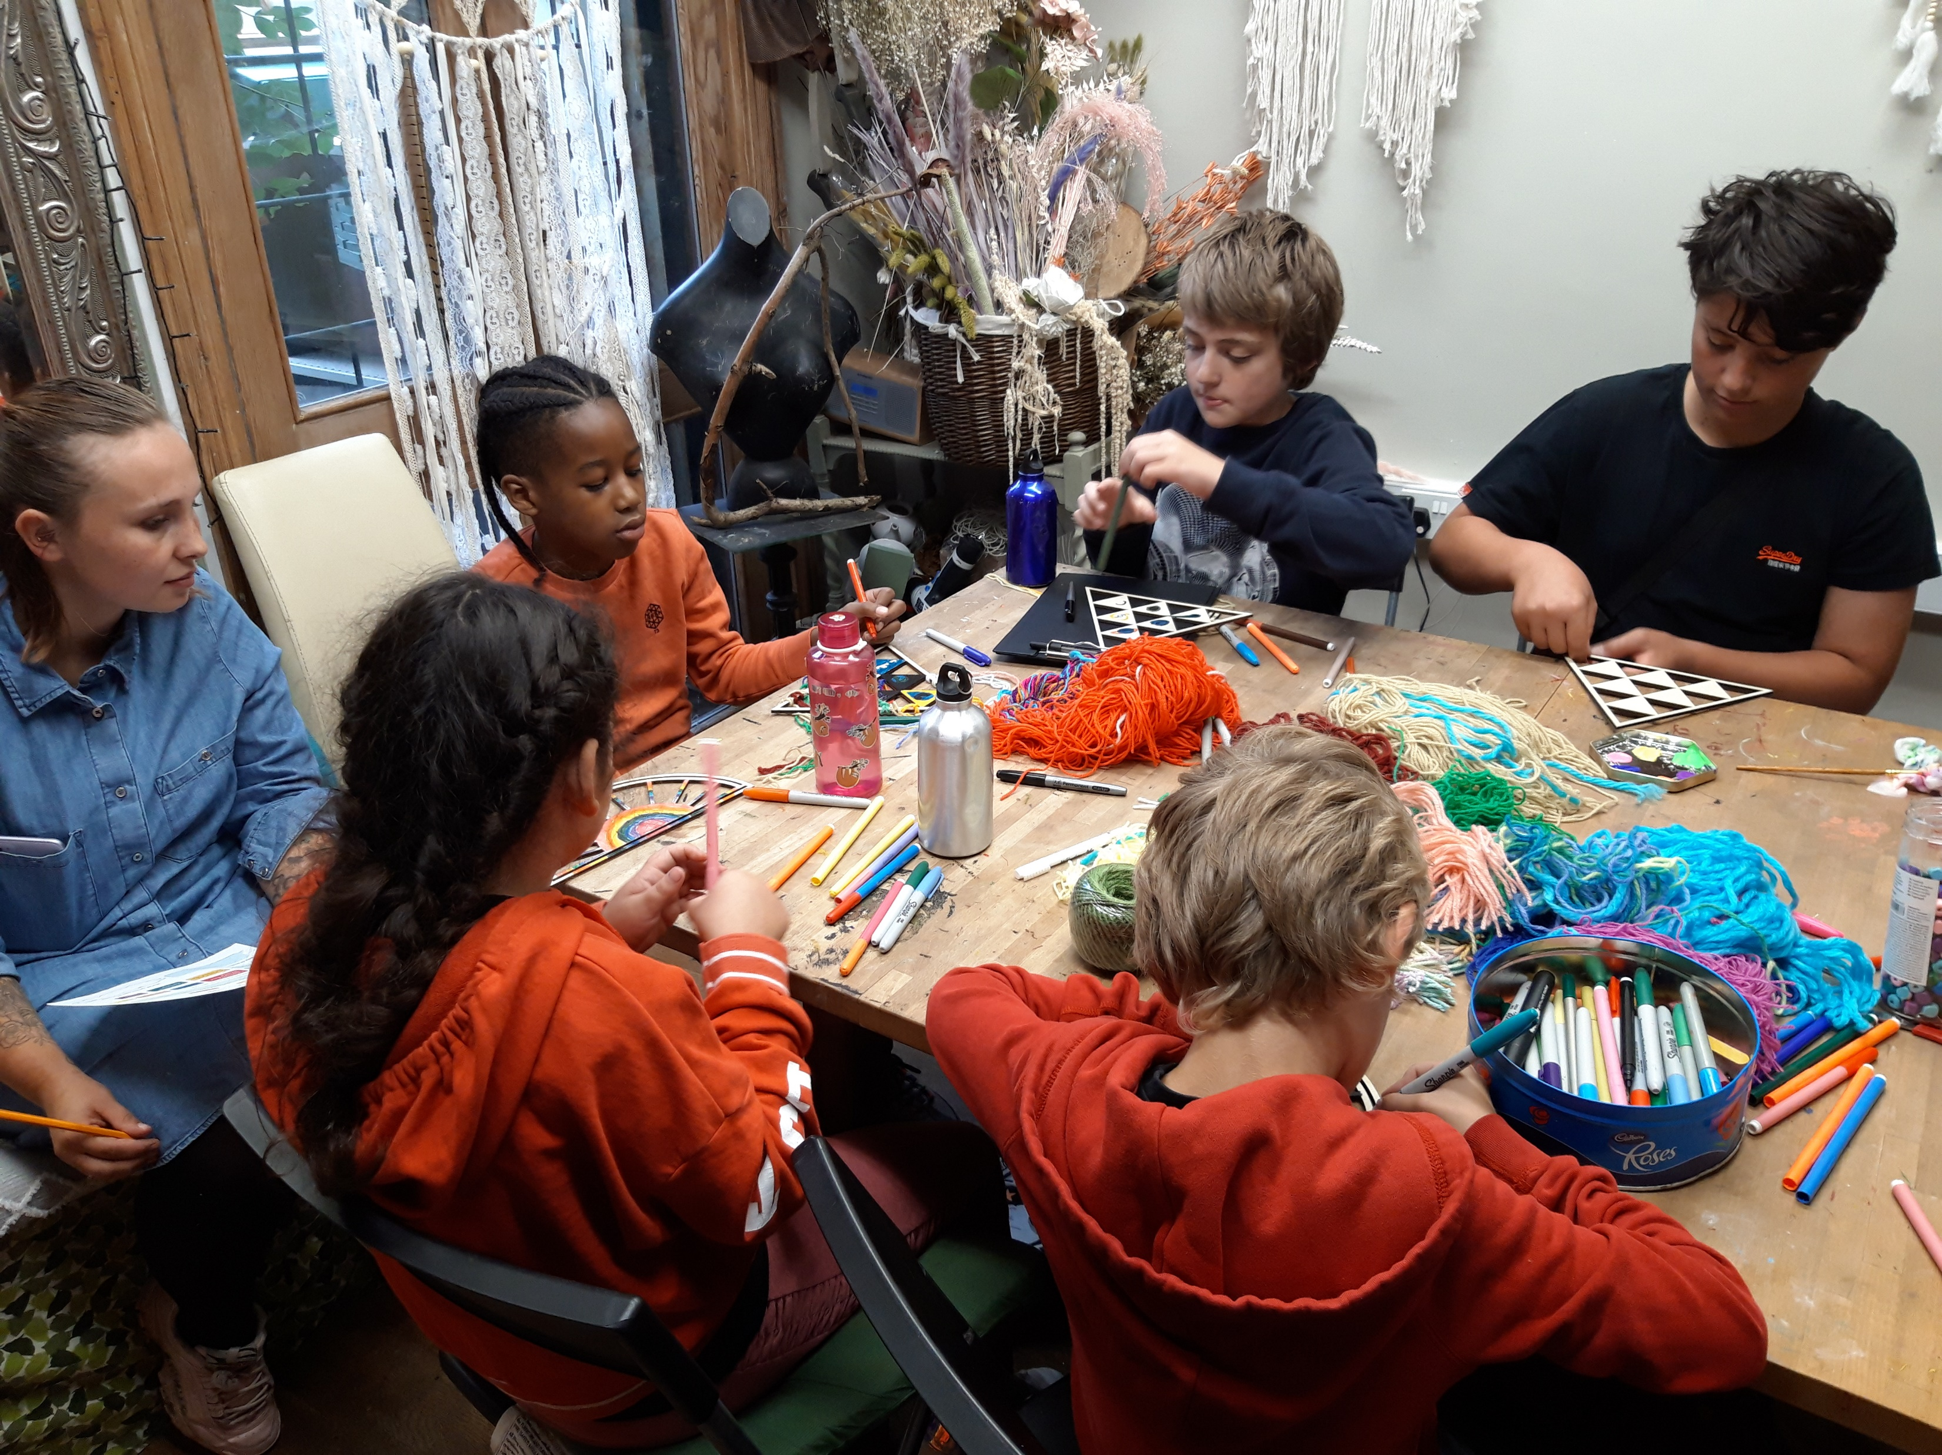
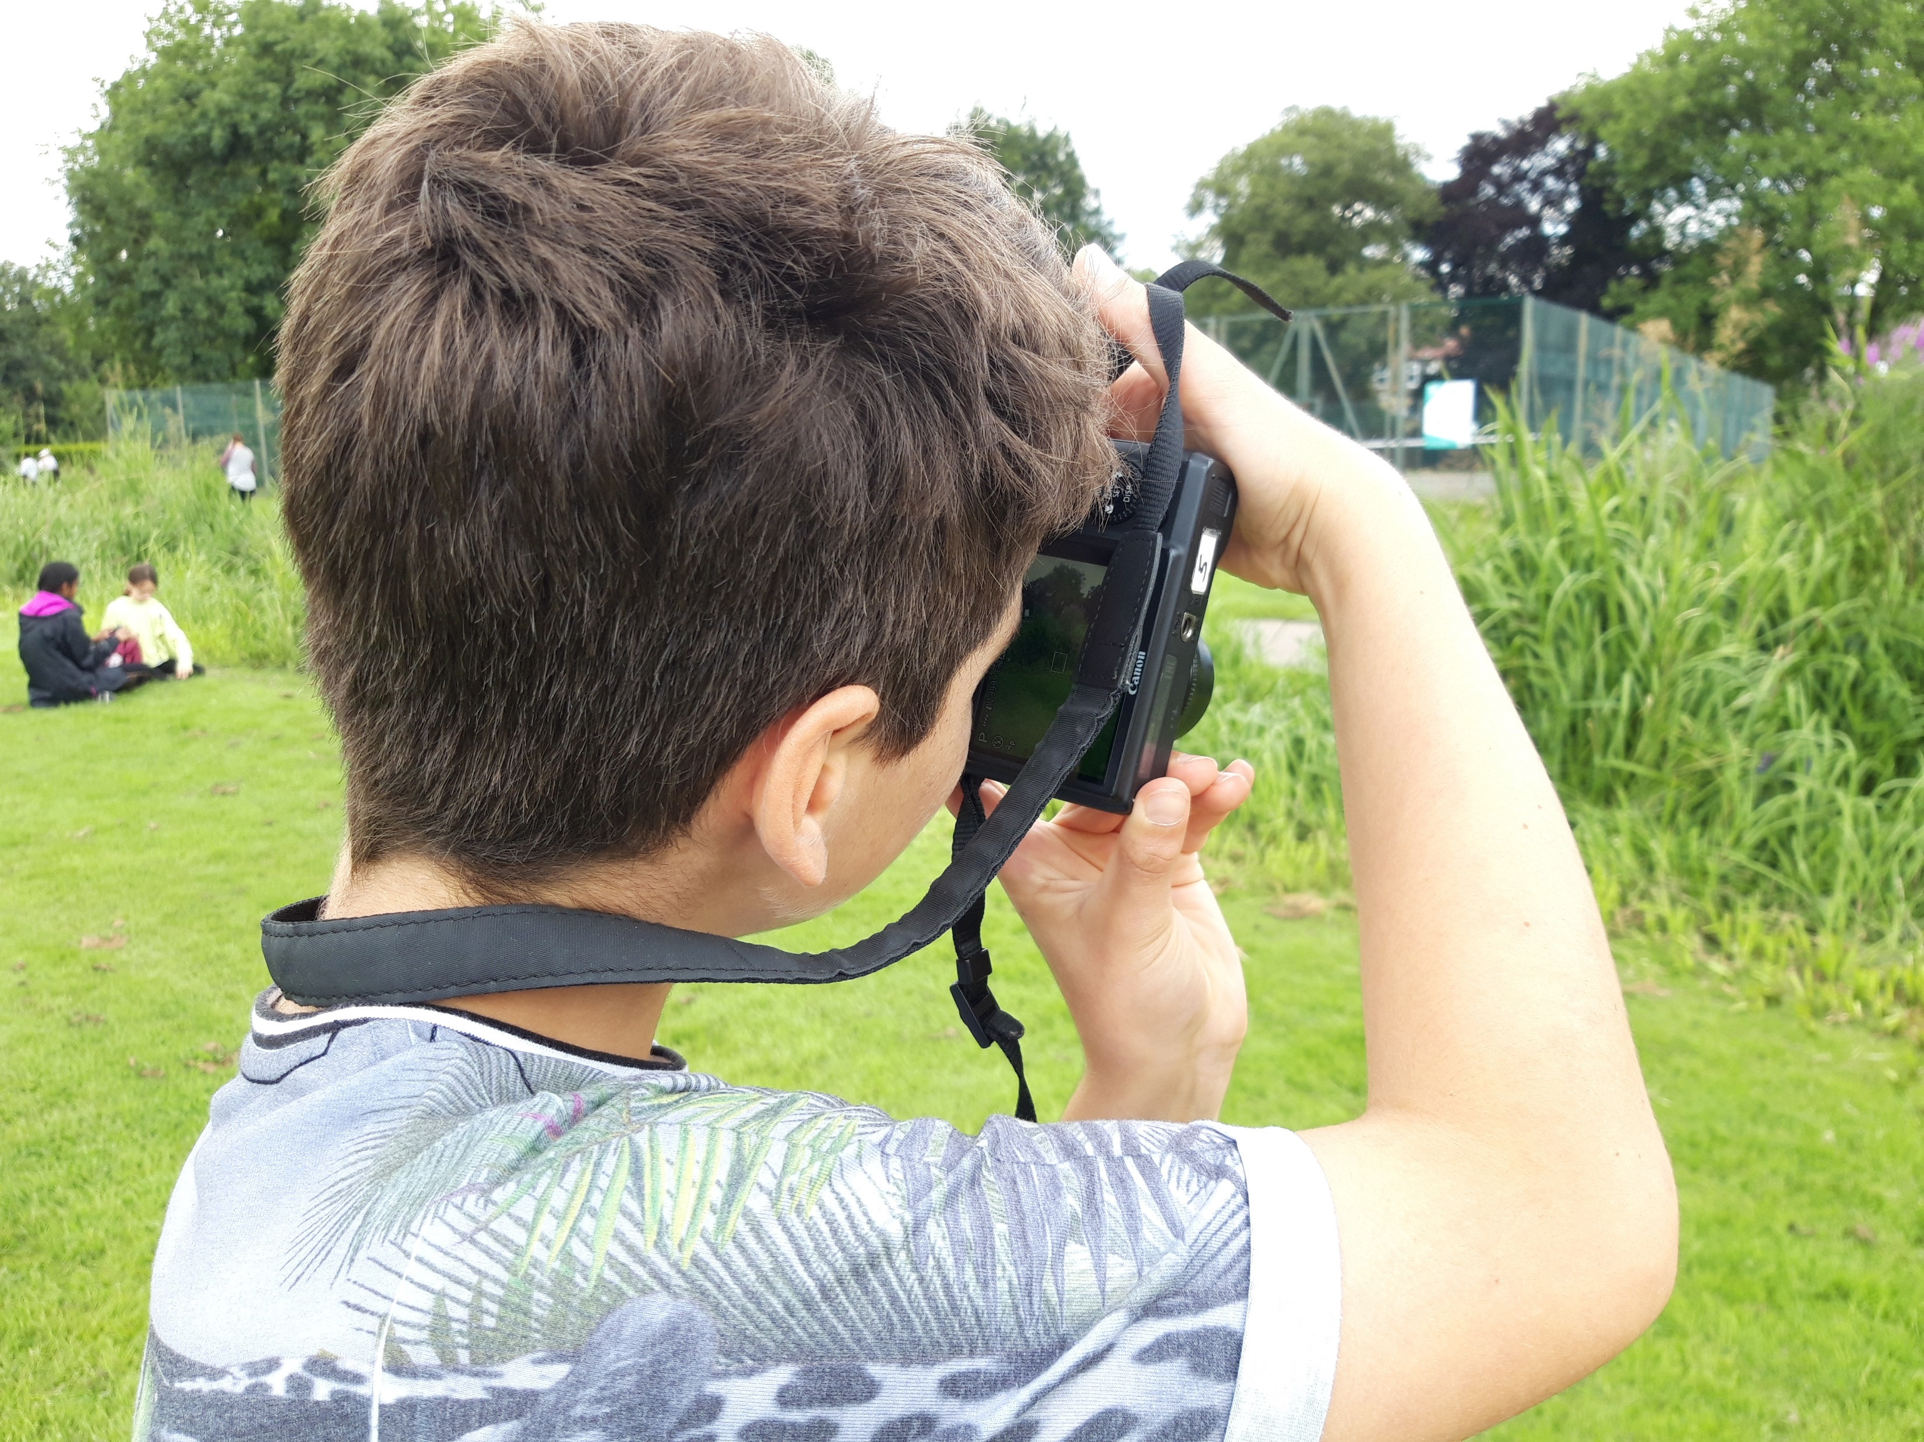
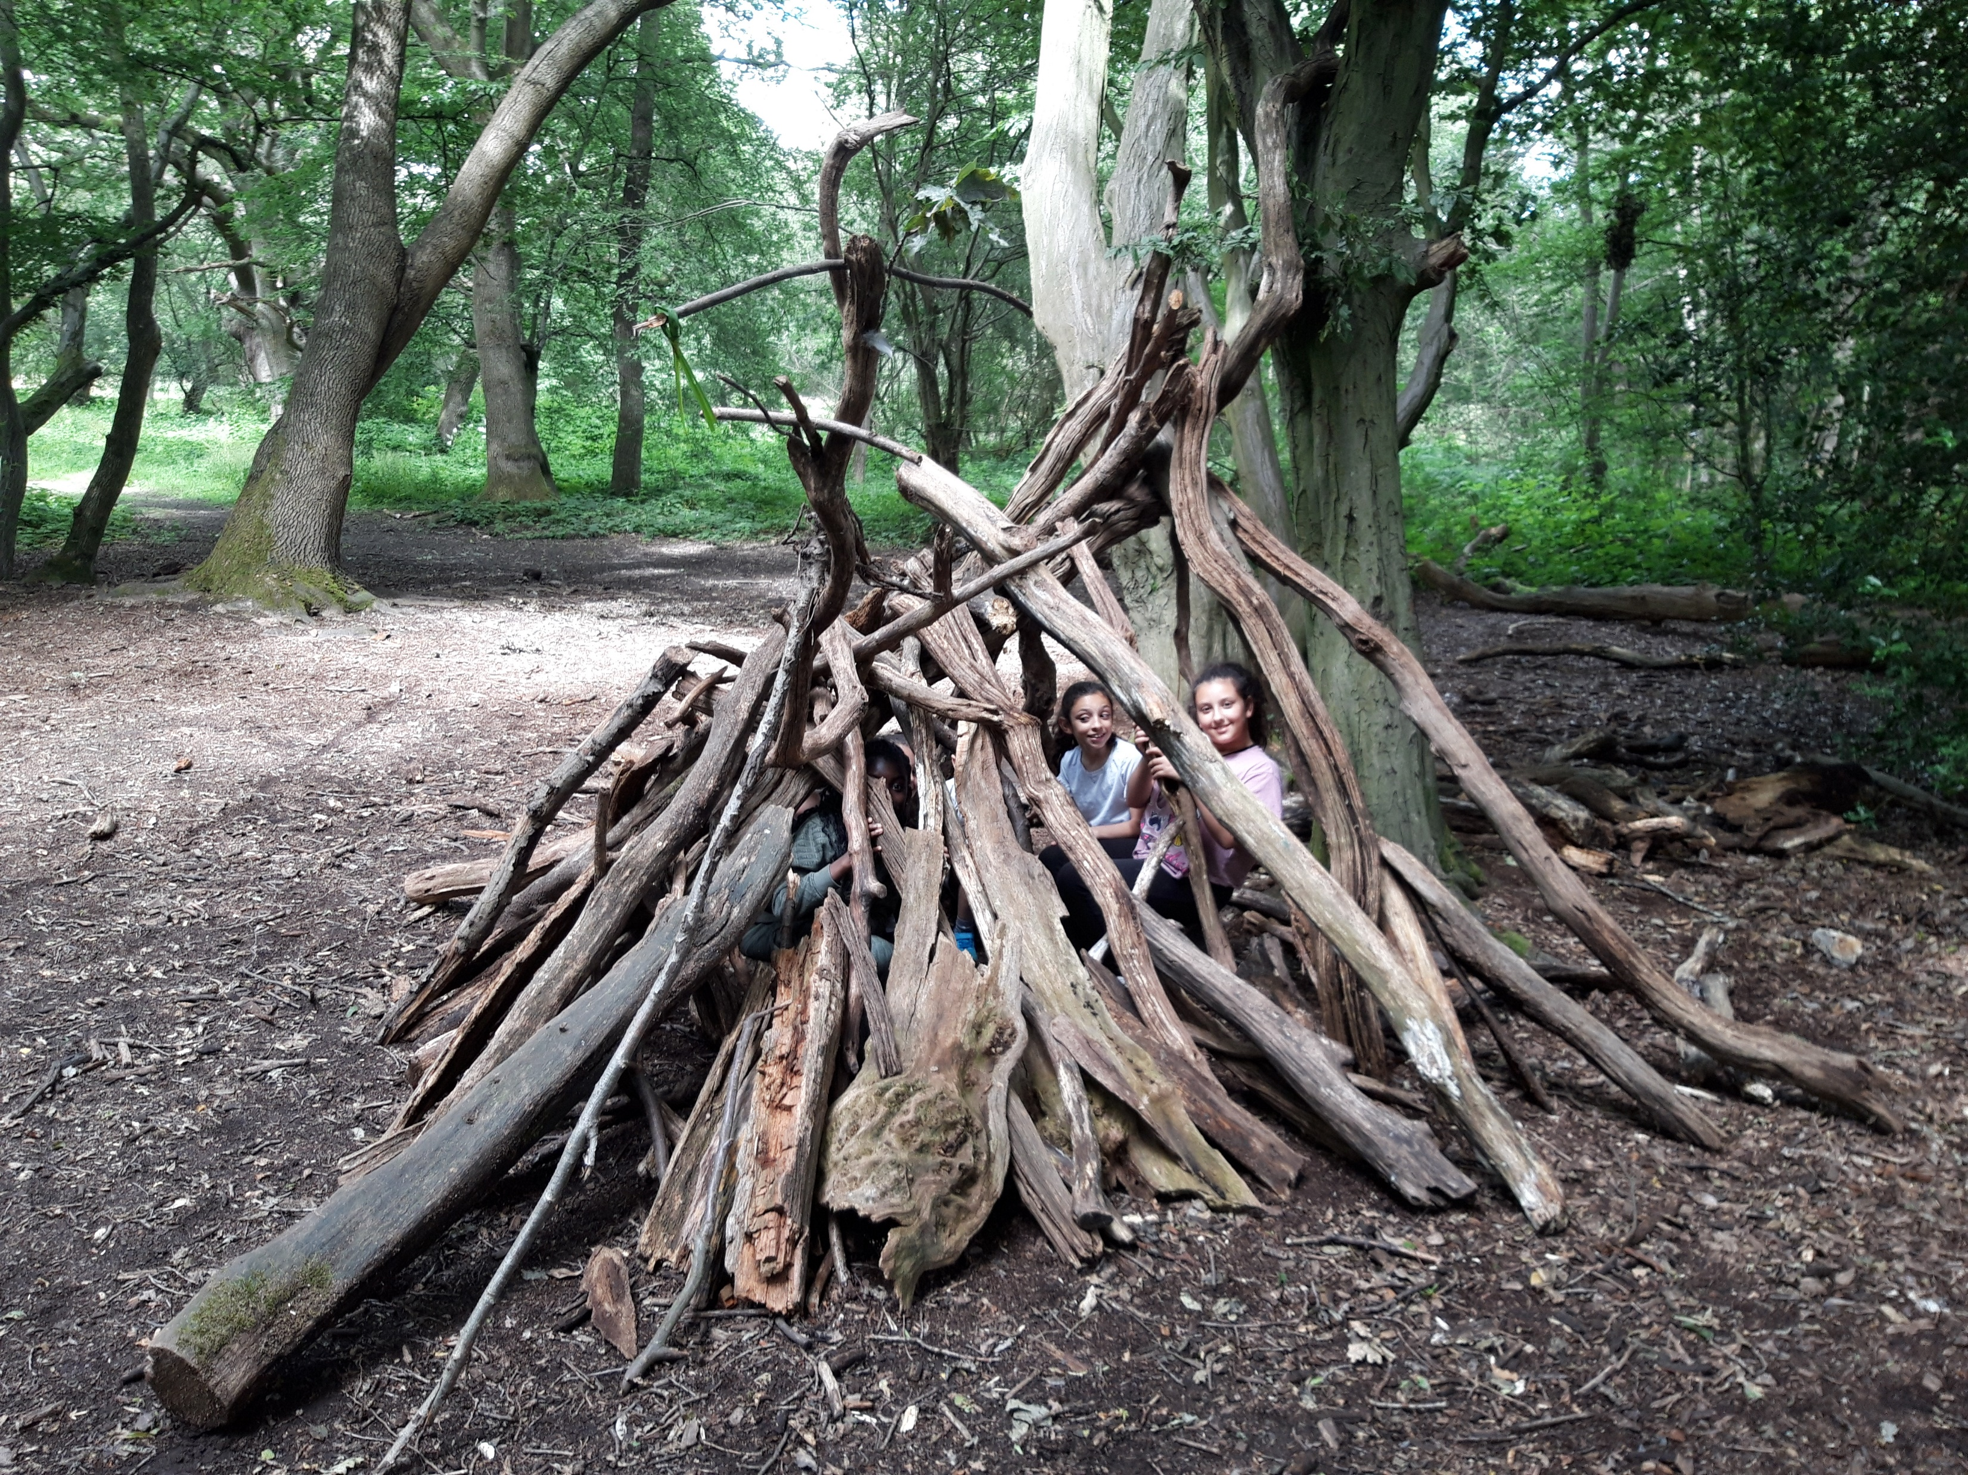
YOUNG CARERS ACTIVITIES
FREE trips and activities
Meet other young carers
Rest and relax
Kindness Club
Homework Club
Transport available!

Slide 14
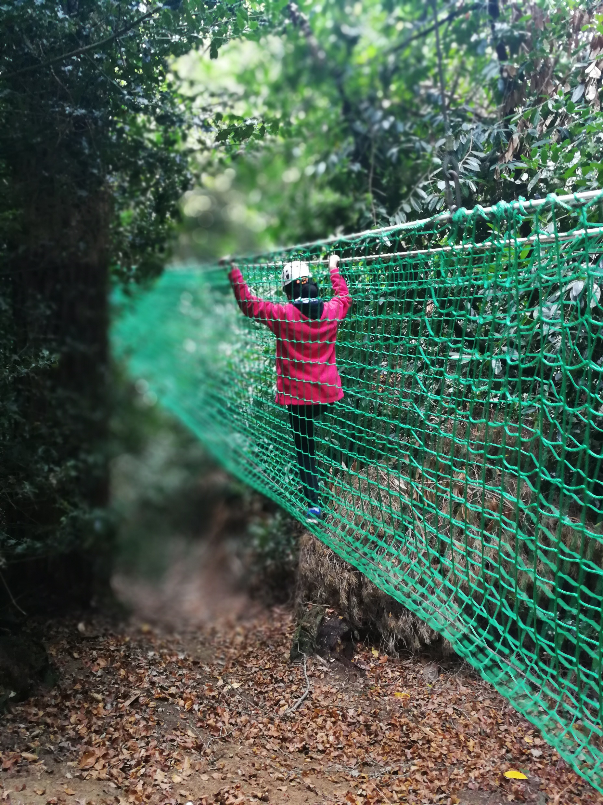
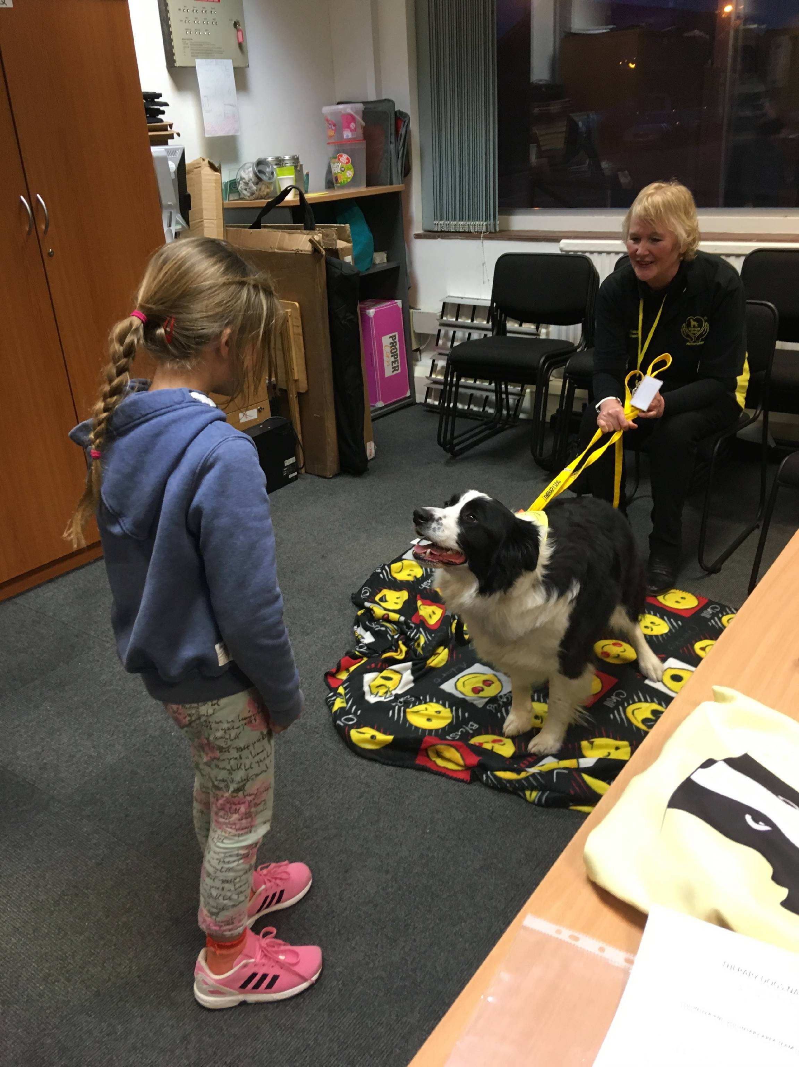
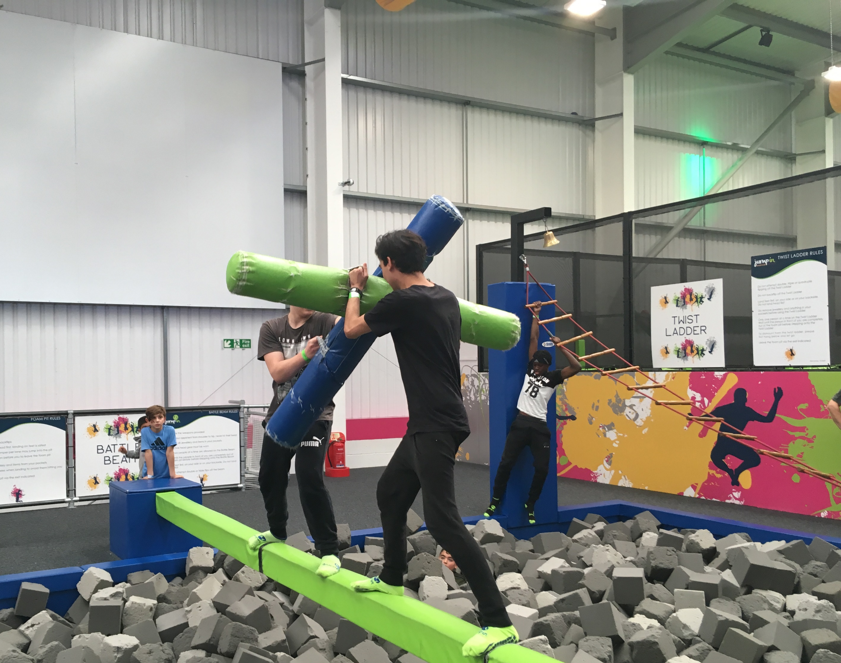
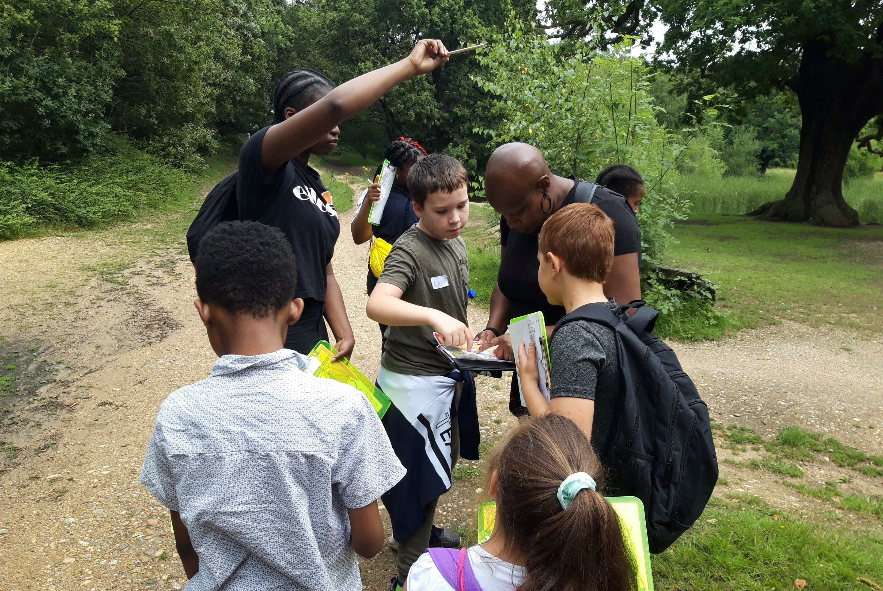
Activities

Slide 17
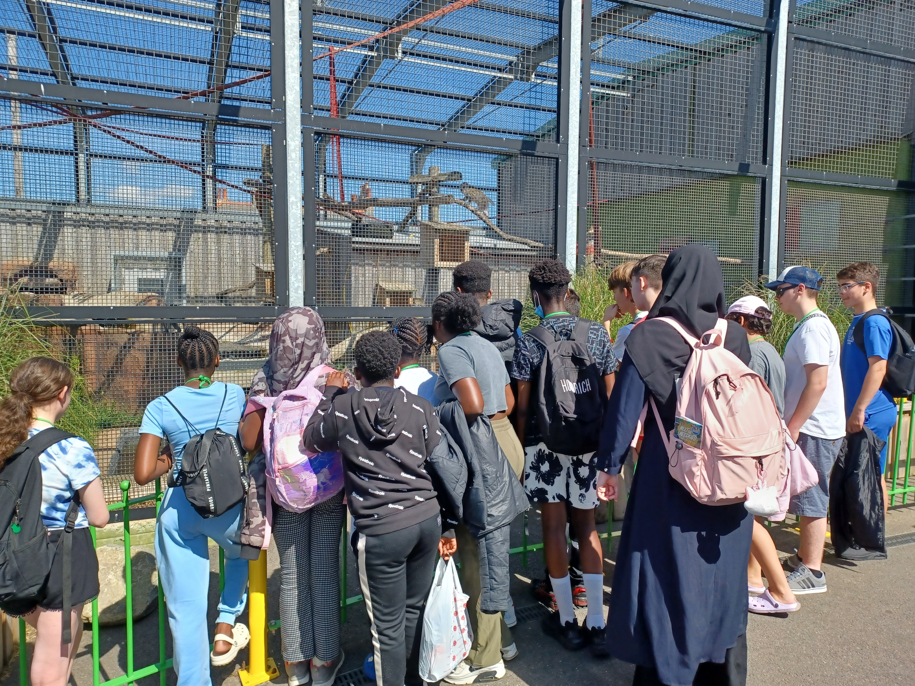

Slide 19
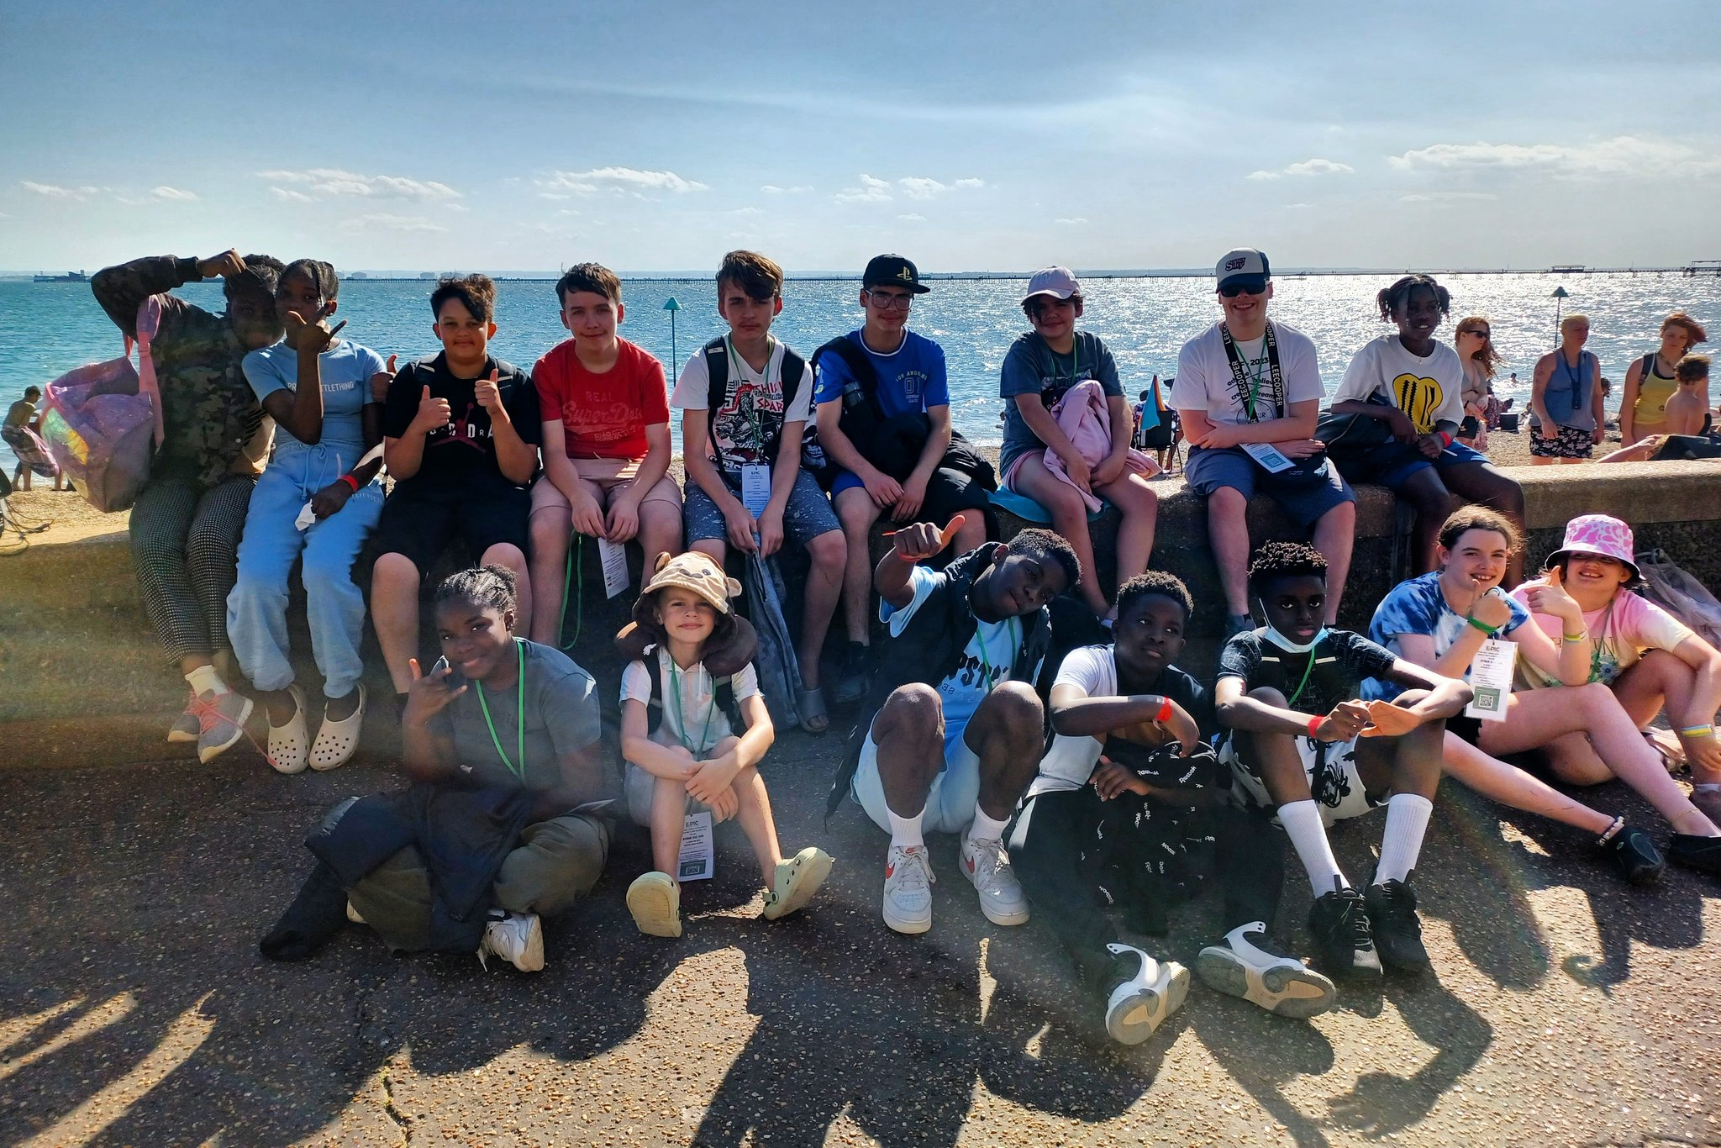

Slide 21
Hear from our young carers

Slide 22
Am I a young carer?
Do you live with someone who is often ill?
Do you live with anyone who often goes to the doctor or hospital?
Was anyone you live with ‘shielding’ during the pandemic?
Do you live with anyone who is often sad and you spend a lot of time trying to cheer them up?
Do you live with anyone who has autism?
Do you spend a lot of time looking after your brothers and sisters?

Slide 23
If you think you may be a young carer…
Chat to us after the assembly
Visit our stall in the playground
Tell your teacher

Slide 24
Any questions?

